Slide 1

Introduction to the Grid Optimized Operation Dispatch (GOOD) Model
BETTER Group (Best Electricity Transition & Transportation Energy Research Group)
October 2024

Slide 2
GOOD Model Structure
Data Processing
Optimization
Results Processing
eGRID
Power plant emissions characteristics
NEEDS
Transmission cost & capacity
Power plant cost characteristics
🪄 MAGIC 🪄
Primary Results
System Cost
Generation Mix
Emissions Rate

Slide 3
Object Oriented Programming (OOP)
Classes: Blueprints for creating objects
Define attributes (data) and methods (functions)
Objects: Instances of classes
Created from class blueprints
Represent specific instances with their own data
Attributes: Variables that belong to a class/object
Instance attributes: Unique to each object
Class attributes: Shared by all instances of the class
Methods: Functions that belong to a class
Define behaviors for objects
Can access and modify object attributes

Slide 4
So why OOP?
Promotes code organization and reusability
Makes it easier to maintain and modify code
Allows for modeling real-world concepts and relationships
Facilitates creation of complex applications with clear structure

Slide 5
GOOD Model Structure
Optimization class
Region objects
Class Optimization(data):
Parse data
Instantiate model
Create objects
Collect parameters
Collect variables
Collect objective
Collect constraints
Solve model
Link objects
Links_{j}
Region_{i}
Links_{j}
Region_{i}
Links_{j}
Region_{i}
Class Generators():
Sets
Parameters
Variables
Objective
Constraints
Class Links():
Sets
Parameters
Variables
Objective
Constraints
Generators
Solar
Wind
Storage
Load

Slide 6

How the Model Works?
Overview of model workflow

Slide 7

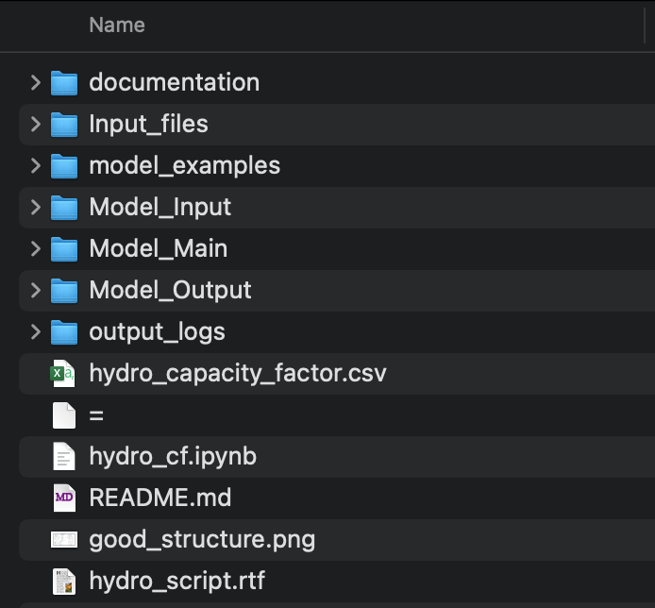
Model Workflow
Input Module
Optimization Module
Output Module

Slide 8
Input Module Overview
Loading Packages
“reading_file.py” (Data Ingestion Script)
“merging_file.py”(Data Merging Script)
Data Processing
Package Importing
Adjusting fuel costs
Input File Preparation for the Main Module
Create Nodes and Links
Save Output as JSON and Pickle Files
Fixing Emission Data
Aggregate Power Plants

Slide 9
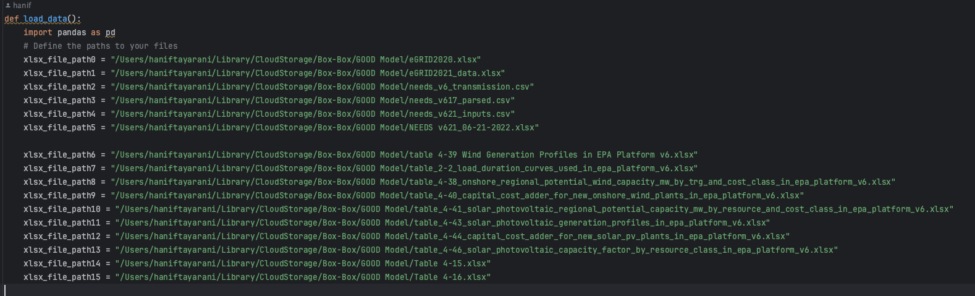
Data Ingestion
reading_file.py
/Users/haniftayarani/good_model/Model_Input/reading_file.py

Slide 10
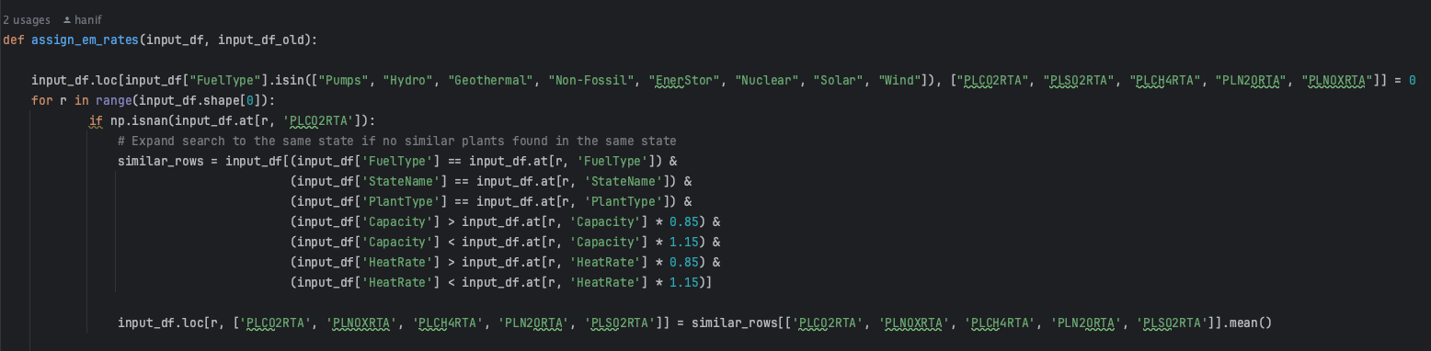
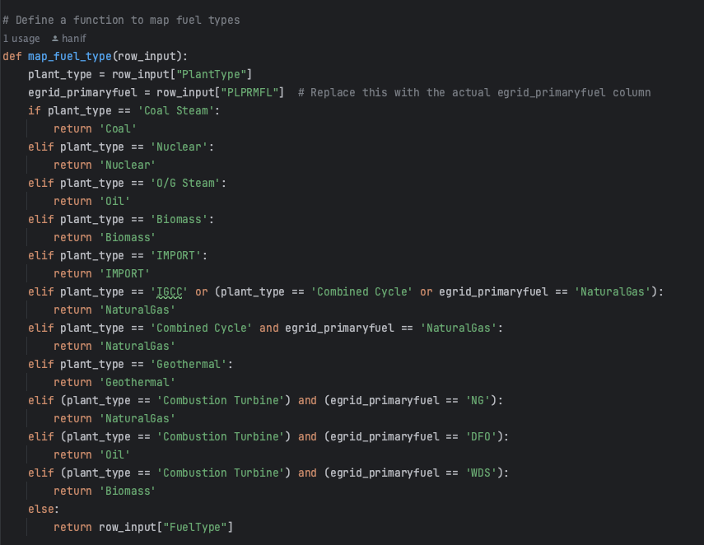
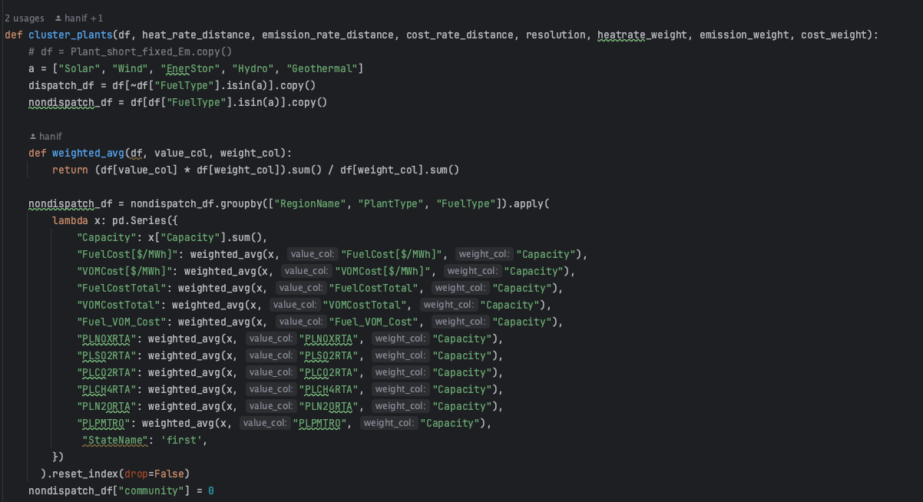
Data Merging Script
merging_file.py
/Users/haniftayarani/good_model/Model_Input/merging_file.py

Slide 11
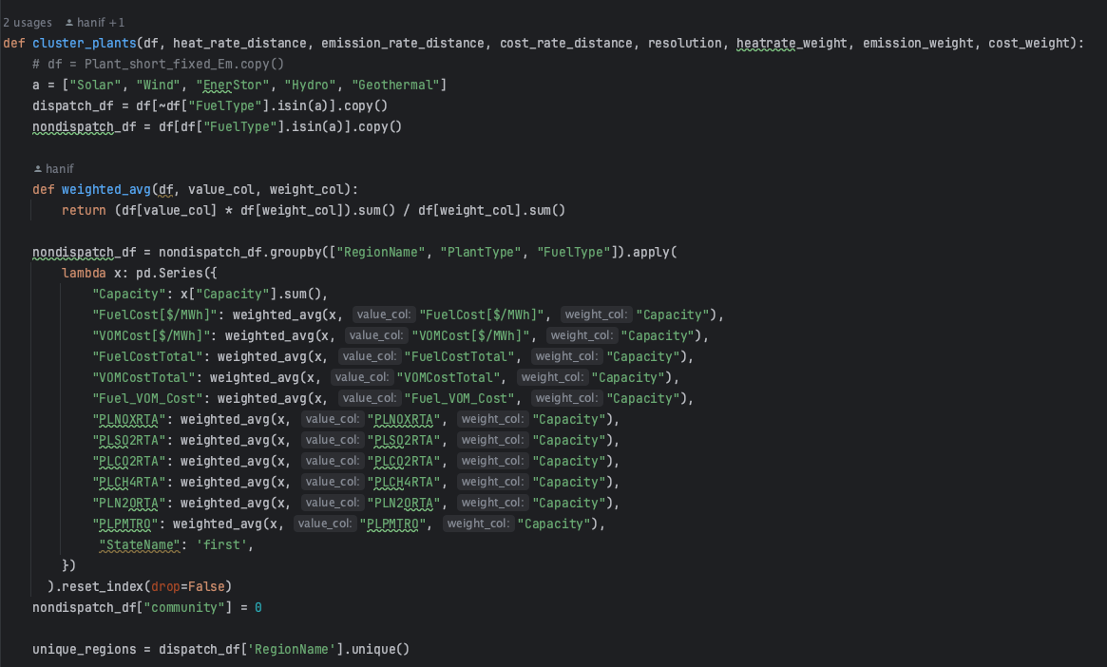
Data Processing
Aggregating power plants
Community Detection using Greedy Modularity Optimization (GMO)

Slide 12
Optimization Module Overview
Initial Setup
Duration of Study
Solar Power Plant Capital Cost
Model Graph Construction
all_input_objects.json
all_input_sets_sorted.json
Preparing Model's Input
Region Selection
RPS Policy Constraint
Optimization Model Configuration
Solver Selection
Monitoring Section Durations
Run the Optimization Model
Saving the Model Output
Wind Power Plant Capital
Constraint deactivation

Slide 13
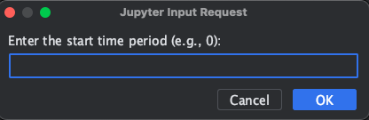
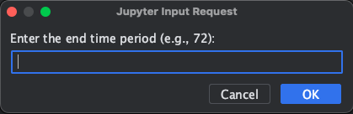
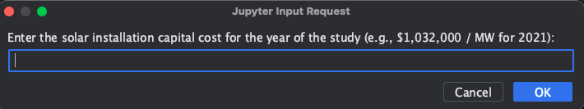
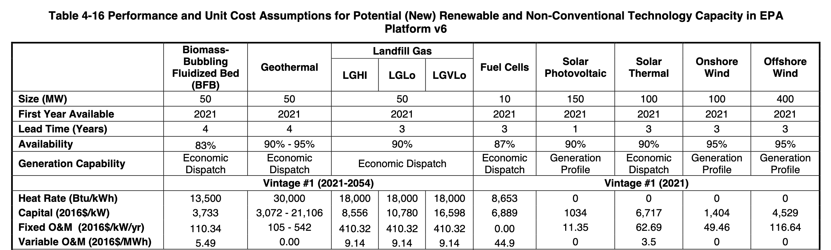
Initial Setup
Duration of Study
Solar Power Plant Capital Cost
Wind Power Plant Capital Cost

Slide 14
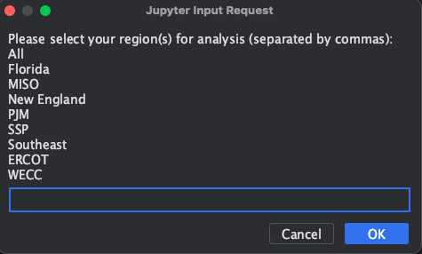
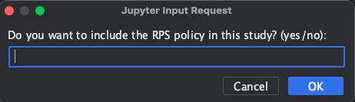
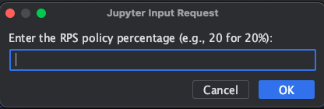
Preparing Model's Inputs
Region Selection
All
Florida
MISO
New England
PJM
SSP
Southeast
ERCOT
WECC
Renewable Portfolio Standard; RPS Policy Constraint

Slide 15
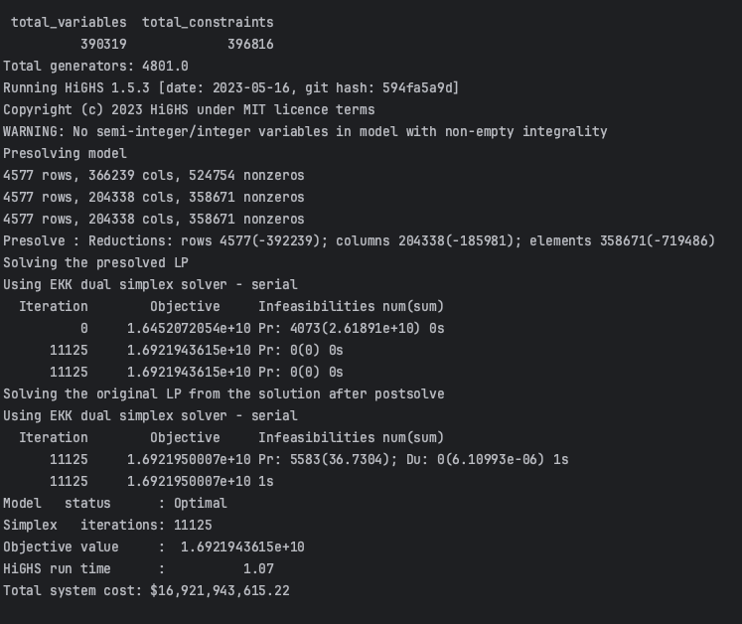
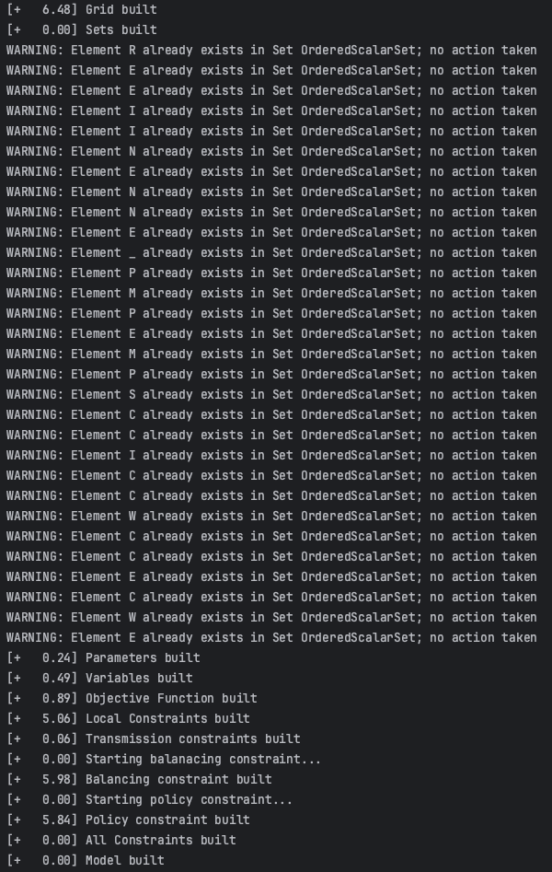
Building and Running the Optimization Model
Solver Selection
Monitoring Section Durations

Slide 16
Output Module Overview
Emission Outputs
Spatial Emission Map
Regional Emission Criteria
Generation Outputs
Installed Capacity Map
Generation Mix
Generation Mix by Hour
Regional Generation Mix

Slide 17
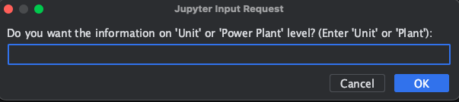
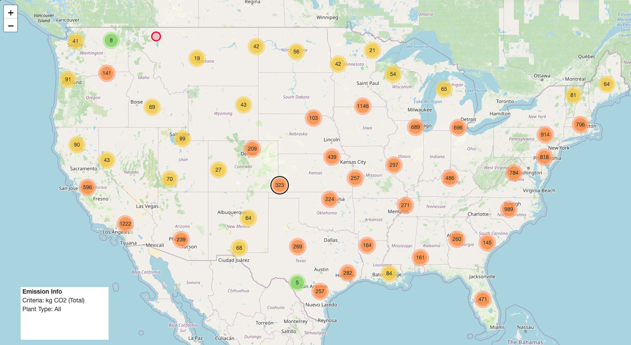
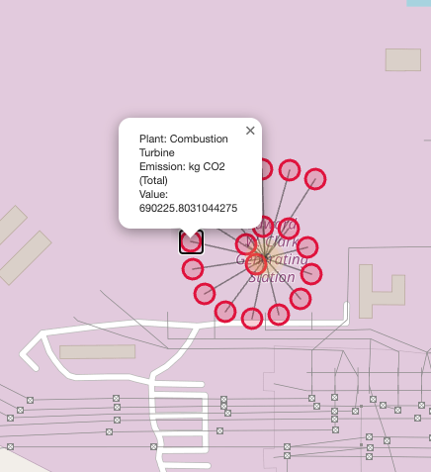
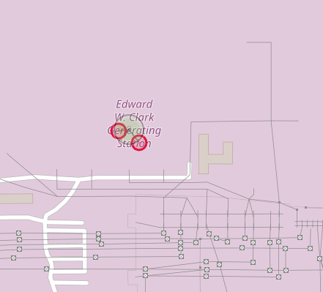
Emission Outputs
Spatial emission map
Unit
Power Plant
Unit
Power Plant

Slide 18
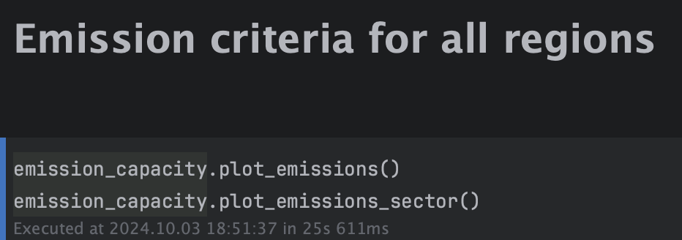
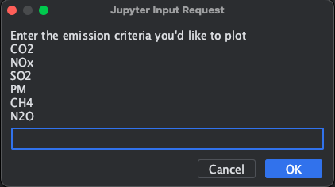
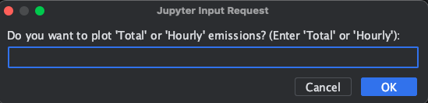
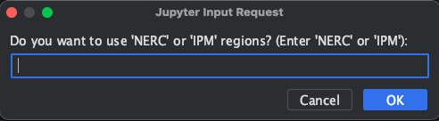
Regional Emission Criteria

Slide 19
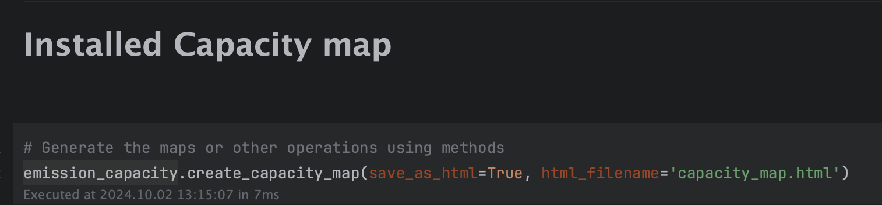
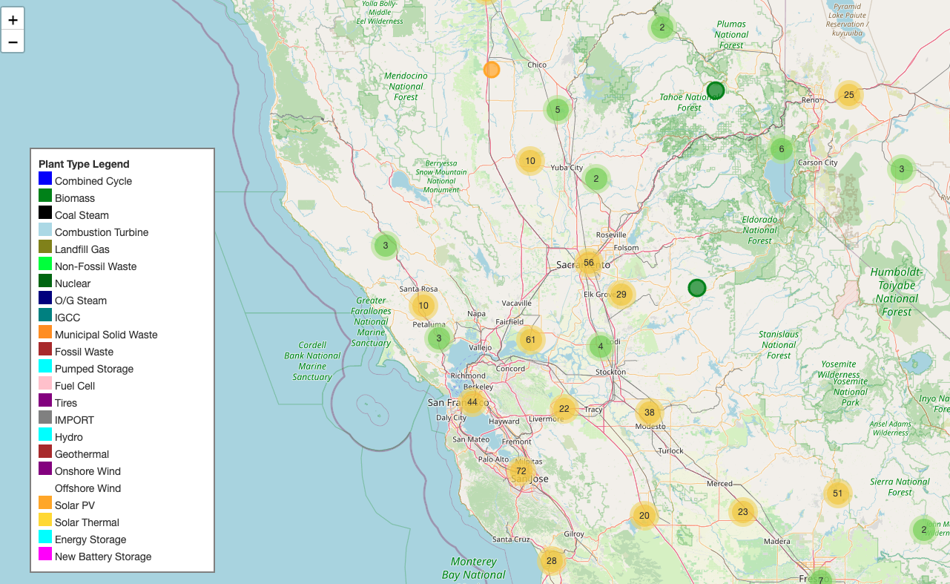
Installed Capacity Map

Slide 20
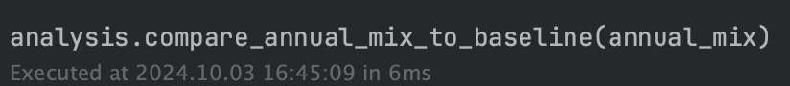
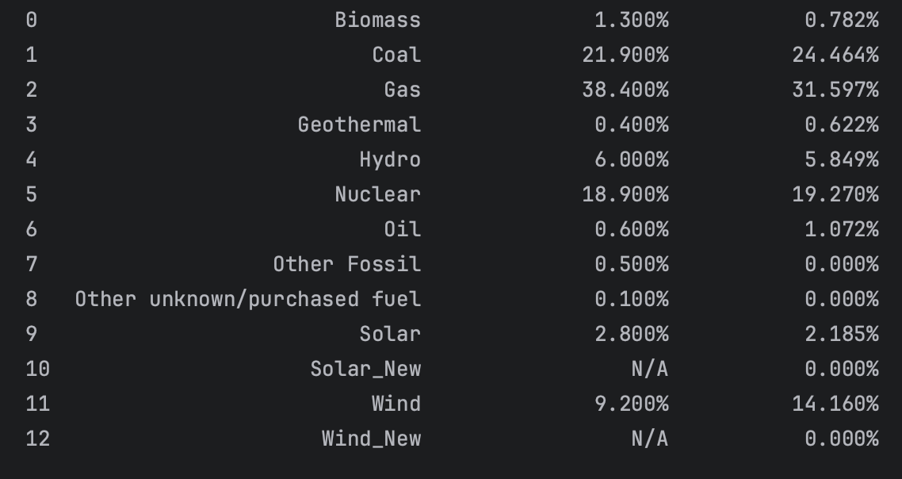
Generation Mix
(All Regions, January 2021)
Baseline (2021)
January 2021

Slide 21
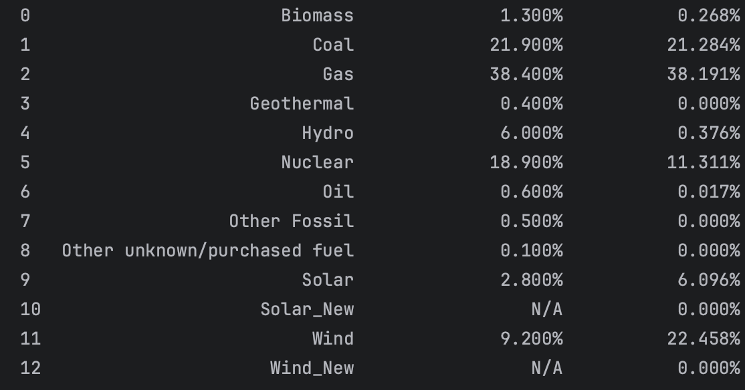
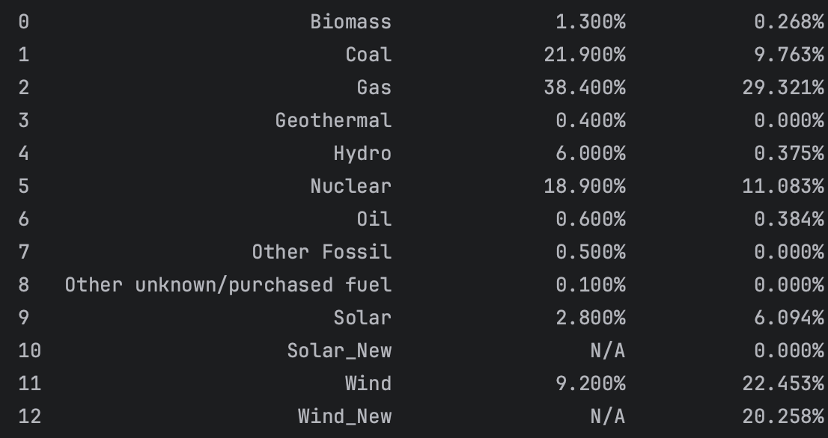
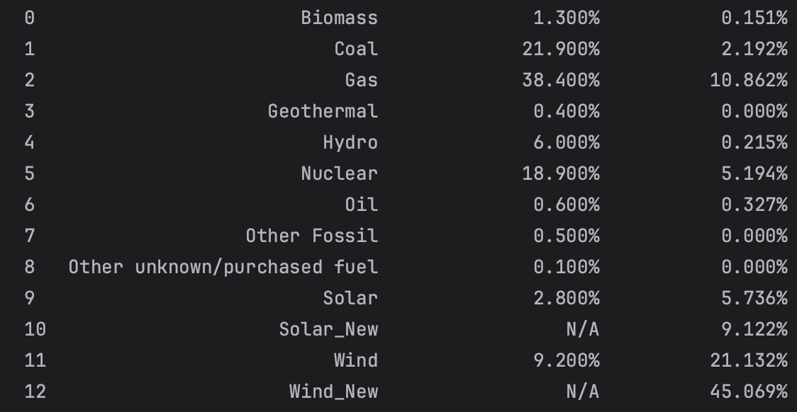
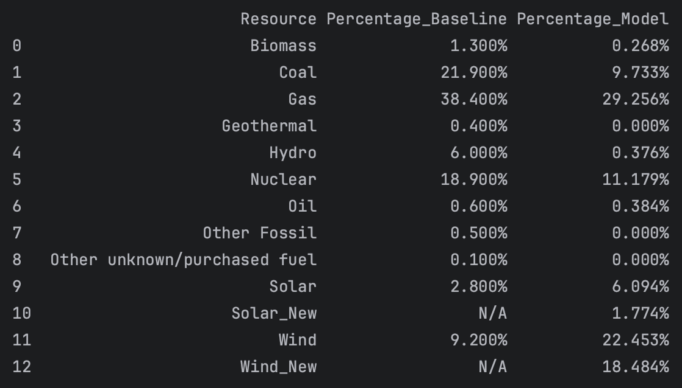
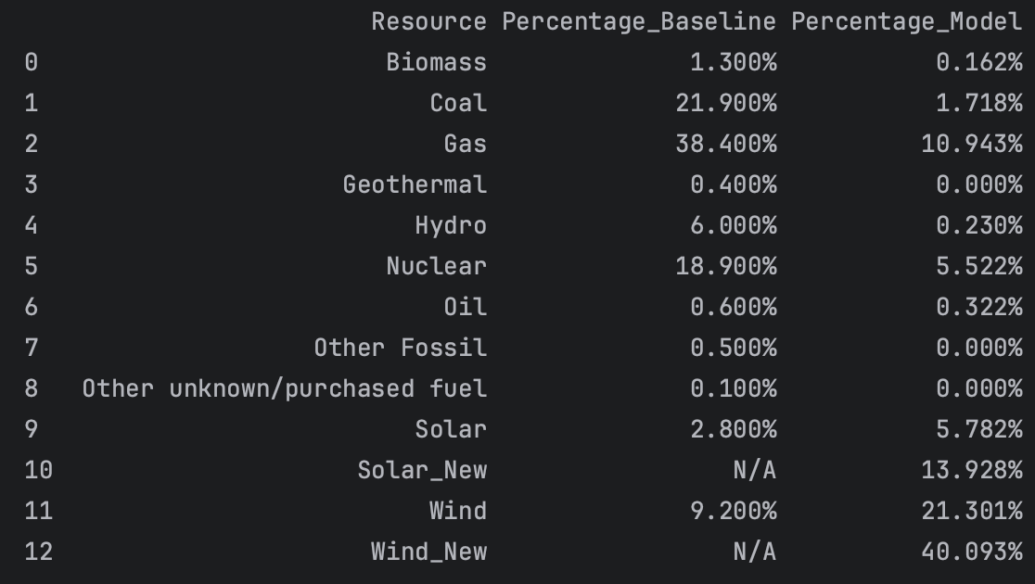
Generation Mix with RPS Policy
Region: ERCOT (year 2021, 8760 hours)
2021 Price
2050 Price
Without RPS
RPS = 40%
RPS = 80%
RPS = 40%
RPS = 80%

Slide 22
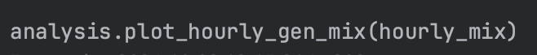
Generation Mix by Hour
All Regions, January
ERCOT, 2021

Slide 23
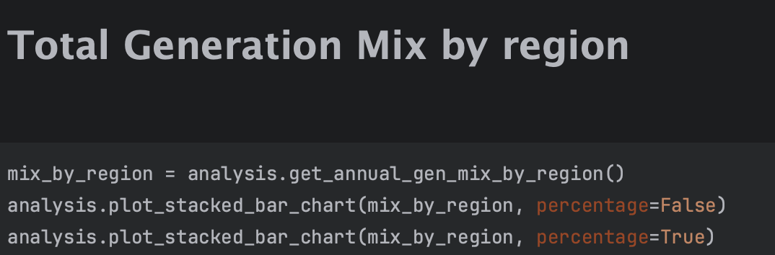
Regional Generation Mix

Slide 24
Regional Generation Mix

Slide 25
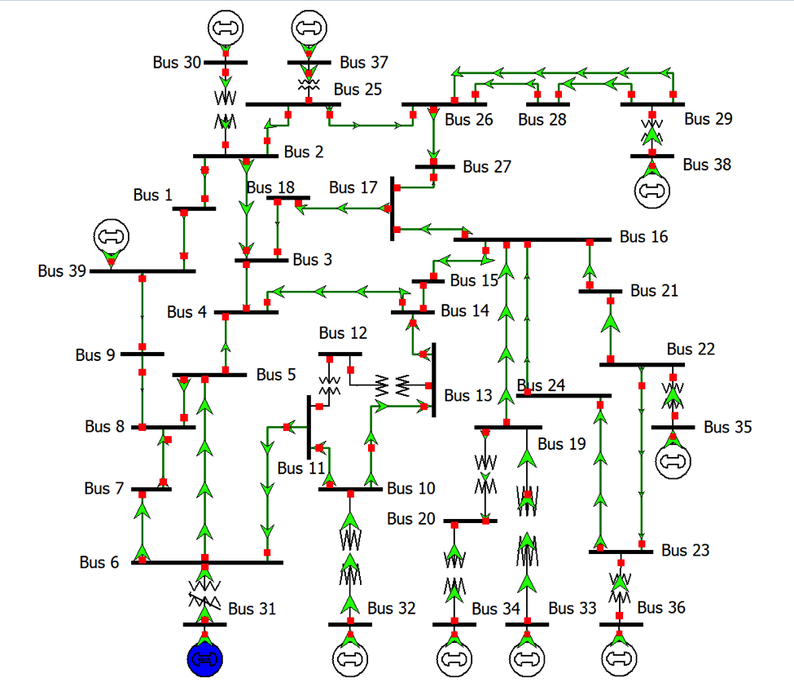
BETTER Group

